Slide 1

Getting Started with VALORANT
Riot api bootcamp
riot-api-bootcamp.thinkific.com

Slide 2


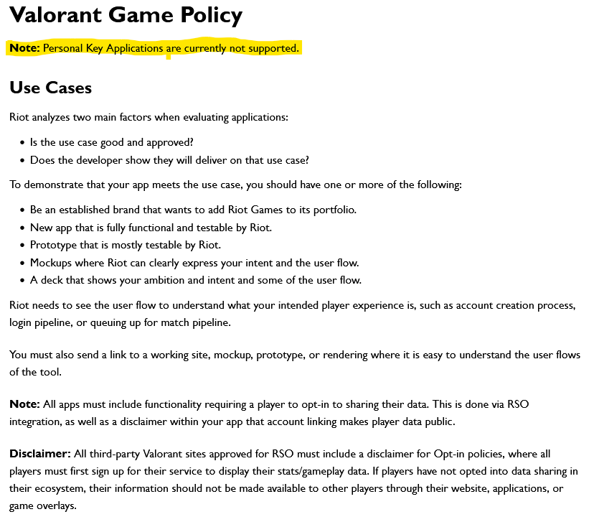


Why is valorant different?

Slide 3



How does this compare with other Riot Games products?
League of Legends
Riot API was originally designed for LoL
Variety of endpoints
Supports tournament game creation
Legends of Runeterra
Gets card info, game state
Mostly interacts with client
Teamfight Tactics
Similar end points to LoL
Specific data is limited (item names, but not effects)
3

Slide 4
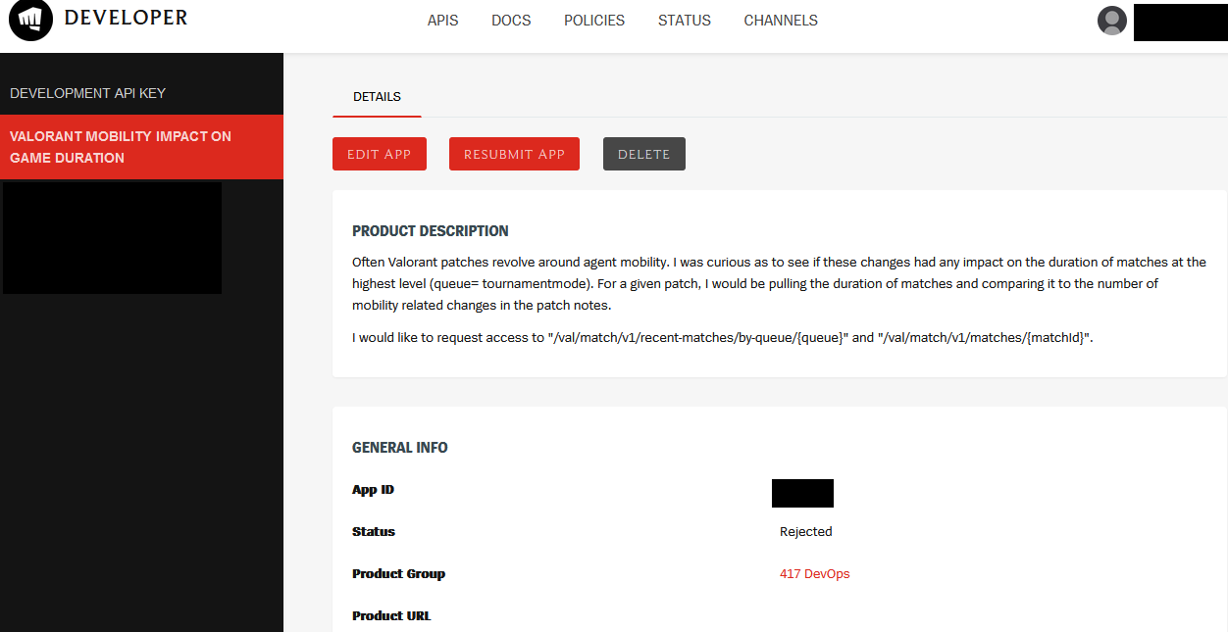

Slide 5
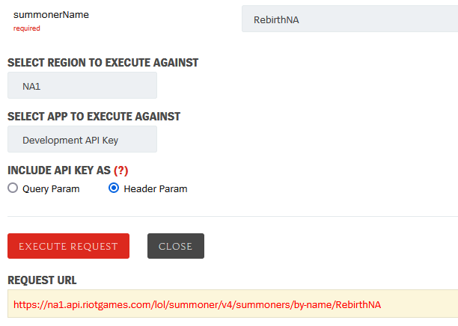
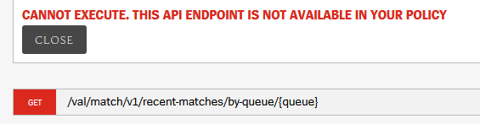
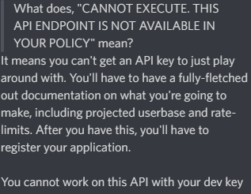
API methods comparison
Summoner-v4 (League)
Val-match-v1 (Valorant)

Slide 6
So how can I build an app without any access?
Riot API BOOTCAMP
riot-api-bootcamp.thinkific.com

Slide 7
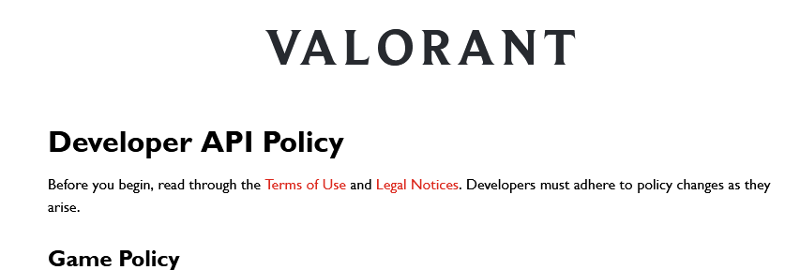
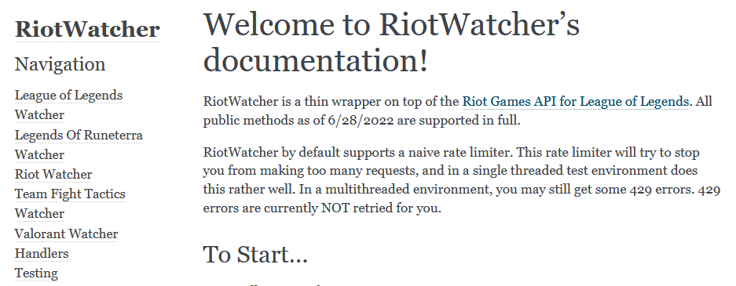
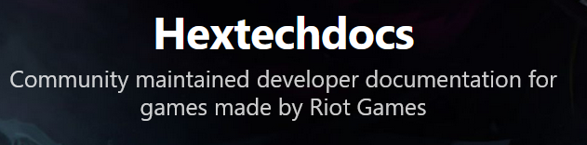
Finding Documentation
There is no official documentation for the Valorant API
Often information is in multiple places
Riot API recommendations: https://developer.riotgames.com/docs/valorant
Python library specific: Riot Watcher (https://riot-watcher.readthedocs.io/en/latest/index.html)
Community documentation: Hextechdocs (https://hextechdocs.dev/ )

Slide 8
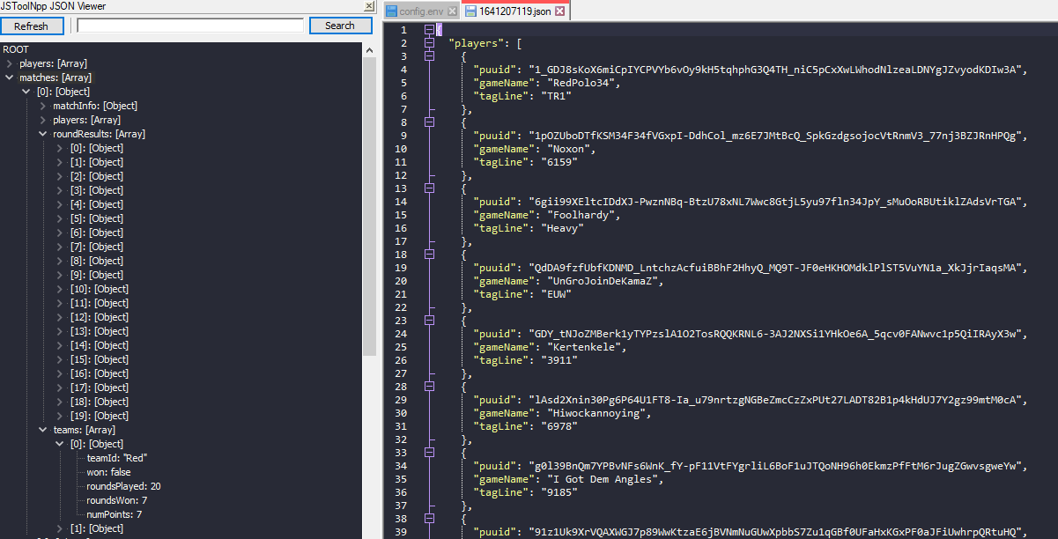
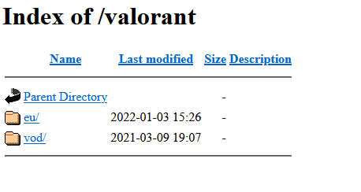
Sample data
Occasionally posted in the Riot Games Developer discord
Raw data: https://stelar7.no/valorant/
Or just scrape people’s GitHub projects

Slide 9
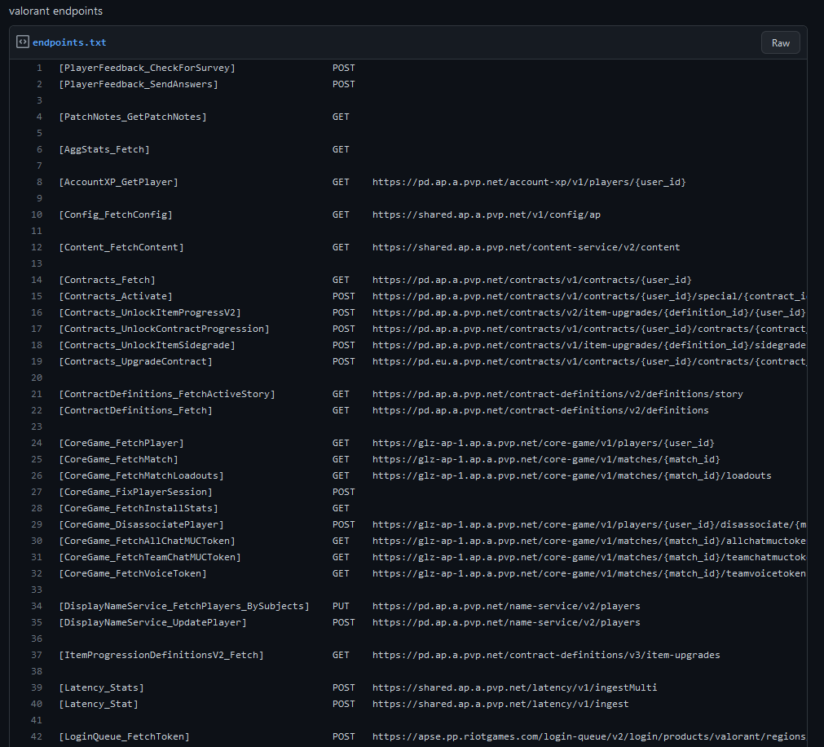
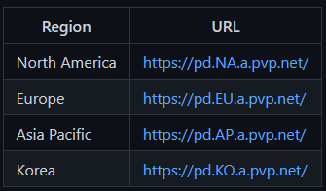
VALORANT API Endpoints
The community has figured it out mostly by trial and error
https://techchrism.github.io/valorant-api-docs/
These aren’t “official” so don’t do anything that would get you banned
Riot has their servers split up between regions, so each region has their own URL.
https://gist.github.com/Kavan72/b6e0bfdf21d610148f64df878b8a2cc5

Slide 10
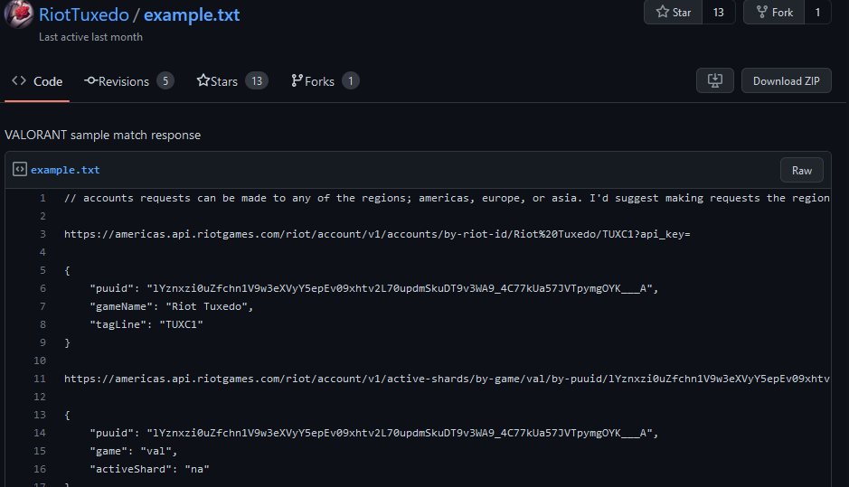
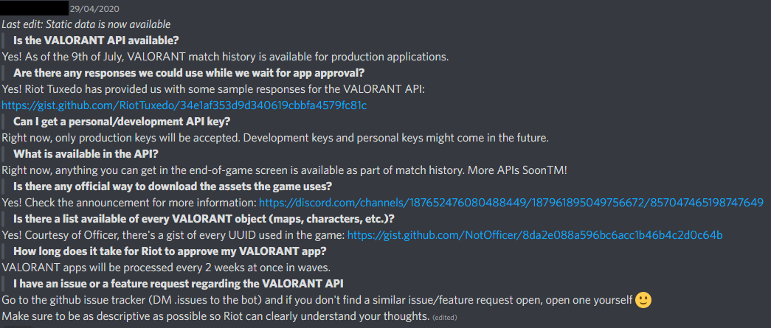
Riot provided sample api responses
Riot FAQs on the VALORANT API from the Riot Developers Discord
https://gist.github.com/RiotTuxedo/34e1af353d9d340619cbbfa4579fc81c

Slide 11
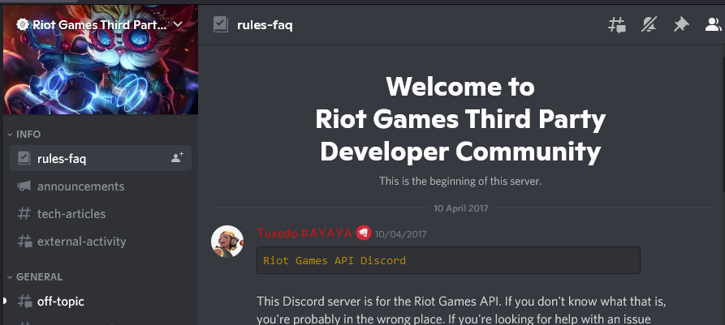
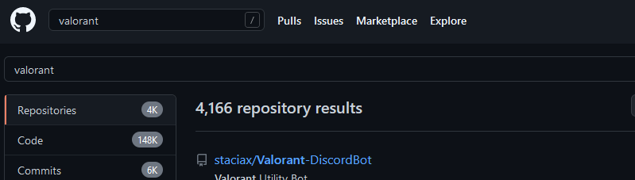
Getting Help
Check past projects!
This is not an endorsement of these projects, and you should double-check their usage/validity.
https://github.com/HeyM1ke/ValorantClientAPI
https://github.com/staciax/Valorant-DiscordBot
https://github.com/HeyM1ke/ValorantStreamOverlay
https://github.com/zayKenyon/VALORANT-rank-yoinker
https://github.com/Soneliem/WAIUA
Ask in Discord servers!
Valorant App developers https://discord.gg/a9yzrw3KAm
Riot Games Developer community https://discord.gg/riotgamesdevrel
Always check the pinned messages first, then use discord’s search, then ask

Slide 12


Questions?
Contact me
It is my hope that this course is easy to understand and follow
Have a question or want additional details? Just reach out!
If you want to know more or have questions about something you’re building, LMK!
riot-api-bootcamp.thinkific.com

